Slide 1

Version Control with Git.

Slide 2
What is version control?
also known as source control.
Tracking and managing changes.
Notes:
Version control, also known as source control, is the practice of tracking and managing changes to software code.
It is a software tools that help software teams manage changes to source code over time.

Slide 3
Popular version control systems..
Git
CVS (concurrent version system)
SVN

Slide 4
Popular Git Commands…
init : The git init command creates a new Git repository
clone : The git clone can be used to copy a existing project on you local computer.
Notes:
The git init command creates a new Git repository. It can be used to convert an existing, unversioned project to a Git repository or initialize a new, empty repository

Slide 5
Popular Git Commands…
log :
See the commits
Author name,
Date
SHA(unique for every single commit).
show :
Same as the git log.
Actual changes to the files.
Notes:
git log command is used to see the commits with their author name, date and the SHA(unique for every single commit).
git show is the same as the git log. Although you can also see what changes or modification happens with the file with git show.

Slide 6
Popular flags with git log…
--oneline : using git log - -oneline you can see all info of individual commit in a single line.
--stat : using git log - -stat you can see the number of lines added or removed.
--patch or –p : git log - - patch command is used to see what actual changes made to the file.

Slide 7
Use of “SHA”
use git log “SHA”
git show “SHA”
Notes:
You can use git log “SHA” to see the commits after that specific SHA only. git show “SHA” as well to see the info regarding that particular commit.

Slide 8
Popular Git Commands…
Add :
Commit :
diff :
tag : git tag v1.0
Notes:
Add : using git add you can add the modified files into the staged files.
Commit : After staging the files you can commit them using git commit –m “appropriate message foe that commit” .
diff : you can use git diff command to see those changes who have not been committed yet.
tag : you can add tags to some extent of your project in-order to capture the specific point in history that is further used to point to a released version. Using git tag v1.0

Slide 9
Popular Git Commands…
Use git branch <branchname> “SHA” to go back to previous commit.
Use git branch –d <branchname> to delete a branch.
Use git merge <nameOfBranchToMergeIn> to merge branches.
In-order to undo the merge use git reset --hard

Slide 10
Merge Conflict Indicators Explanation
<<<<<<<
|||||||
=======
>>>>>>>
Notes:
<<<<<<< HEAD everything below this line (until the next indicator) shows you what's on the current branch.
||||||| merged common ancestors everything below this line (until the next indicator) shows you what the original lines were.
======= is the end of the original lines, everything that follows (until the next indicator) is what's on the branch that's being merged in.
>>>>>>> heading-update is the ending indicator of what's on the branch that's being merged in (in this case, the heading-update branch).

Slide 11
Popular Git Commands…
You can use git commit - -amend –m “new message” to amend the most recent commit you have made.
You can use git revert “SHA-of-commit-to-revert” in-order to reverse the given commit.
You can use git reset <reference-to-commit> in-order to erase the commit.

Slide 12
Relative Commit References…
The parent commit :
HEAD^
HEAD~
HEAD~1
The grandparent commit:
HEAD^^
HEAD~2
The great-grandparent commit:
HEAD^^^
HEAD~3

Slide 13
Git Reset's Flags..
--mixed :
--soft :
--hard :
Notes:
--mixed : It is a “default” tag as well. Though - -mixed tag commits ahead moves to the working-directory.
--soft : Though - -soft tag commits ahead moves to the stagging-directory.
--hard : Though - -mixed tag commits ahead moves to the trash.

Slide 14
Merging vs. Rebasing
Solves the same problem
Integrate changes from one into another branch.
Notes:
The first thing to understand about git rebase is that it solves the same problem as git merge. Both of these commands are designed to integrate changes from one branch into another branch—they just do it in very different ways.

Slide 15
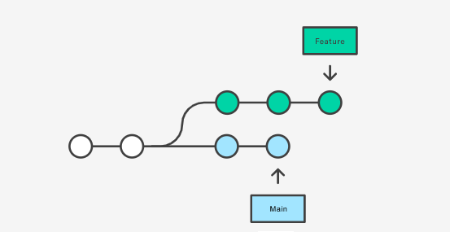
Understanding through an example…
Consider you are working on feature branch. But another teammate updated something on main branch.

Slide 16
Options you have?
Merging
Rebasing.

Slide 17
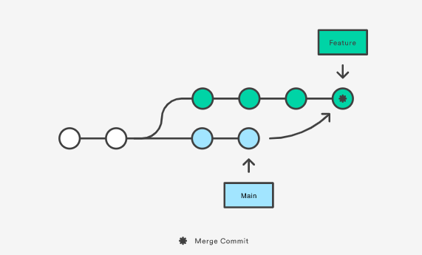
In case of merging…
git checkout feature
git merge main
This creates a new “merge commit” in the feature.
If the main is very active it
will pollute your history.

Slide 18
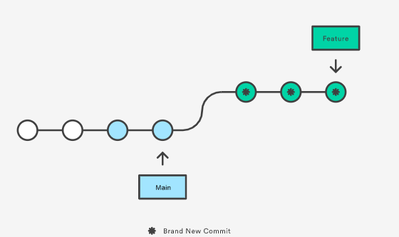
If you go for the Rebase Option…
git checkout feature
git rebase main
Notes:
This moves the entire feature branch to begin on the tip of the main branch, effectively incorporating all of the new commits in main. But, instead of using a merge commit, rebasing re-writes the project history by creating brand new commits for each commit in the original branch.

Slide 19
Benefit of rebasing…
Cleaner project history
unnecessary merge commits
perfectly linear project history.
Notes:
The major benefit of rebasing is that you get a much cleaner project history. First, it eliminates the unnecessary merge commits required by git merge. Second, as you can see in the above diagram, rebasing also results in a perfectly linear project history.

Slide 20

Interactive Rebasing…
Alter commits
powerful than an automated rebase
git checkout feature
git rebase -i main
This will open a text editor listing all of the commits that are about to be moved.
Notes:
Interactive rebasing gives you the opportunity to alter commits as they are moved to the new branch. This is even more powerful than an automated rebase.

Slide 21
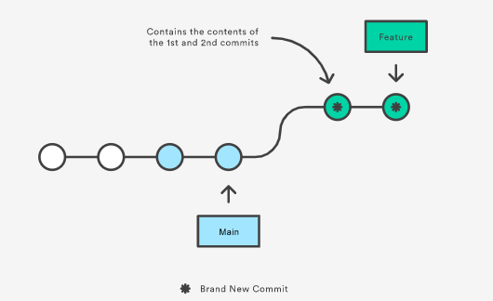

Interactive Rebasing…
If the 2nd commit fixes a small problem in the 1st commit, you can condense them into a single commit with the fixup command.
Result ➔

Slide 22
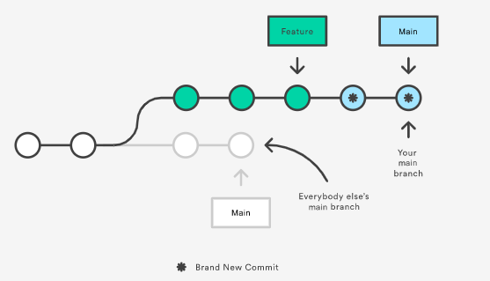
The Golden Rule of Rebasing…
Notes:
Once you understand what rebasing is, the most important thing to learn is when not to do it. The golden rule of git rebase is to never use it on public branches.

Slide 23
Any Questions?????

